Slide 2
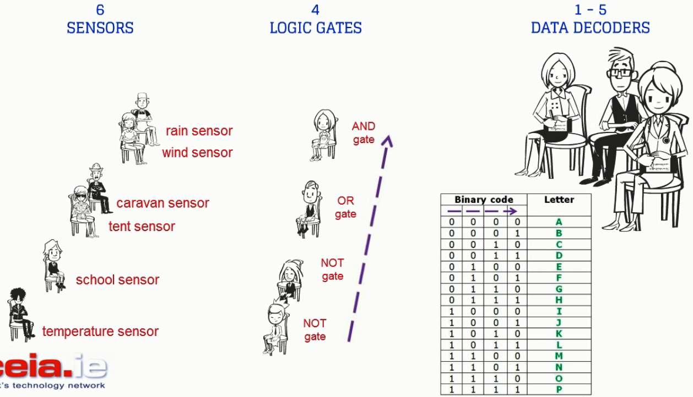
Bo01ean Logic Game – Arrangement

Slide 3
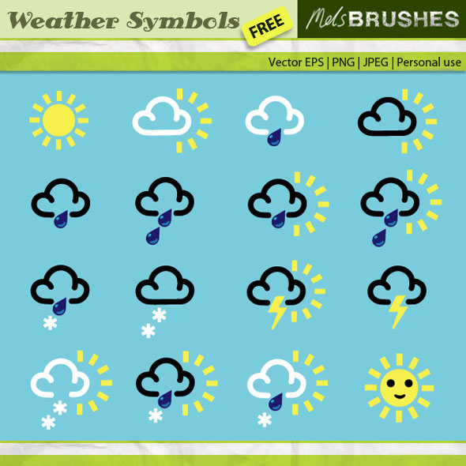
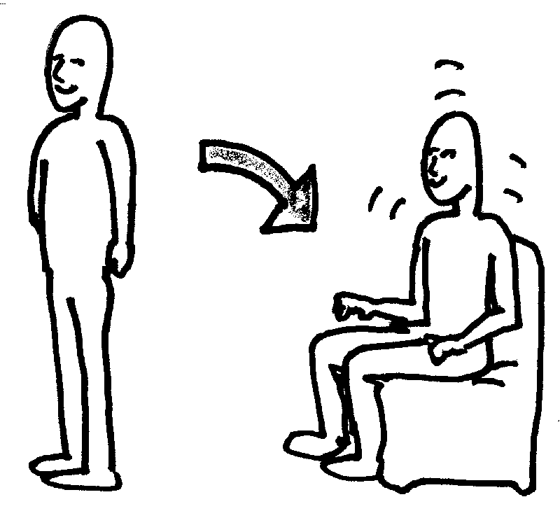

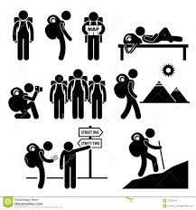


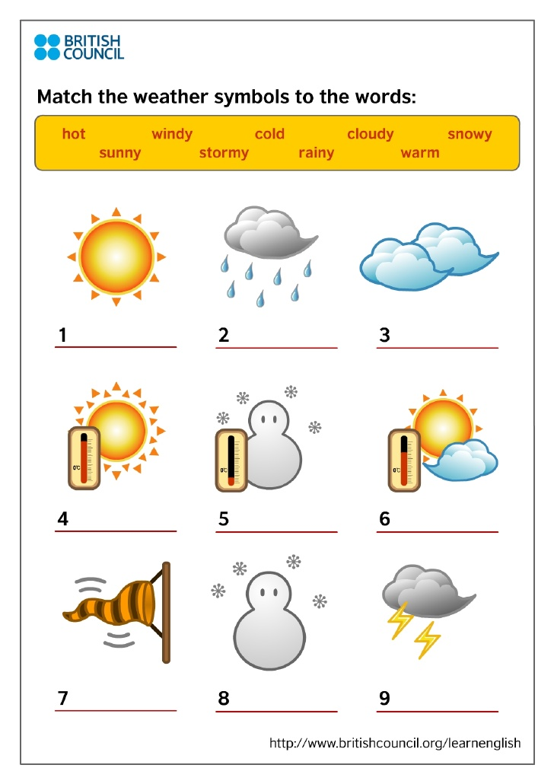


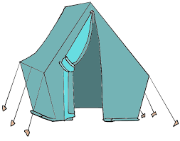
Bo01ean Logic Game - SENSOR Cards
RAIN sensor
CARAVAN sensor
SCHOOL sensor
T_{min}=15°C
WIND sensor
TENT sensor
TEMPERATURE sensor

Slide 4
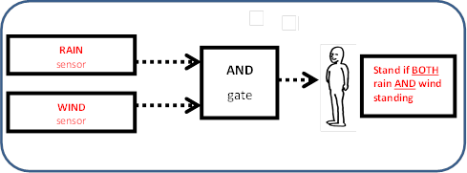
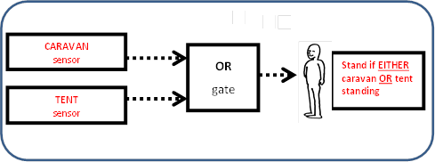
Bo01ean Logic Game – LOGIC GATE Cards

Slide 5
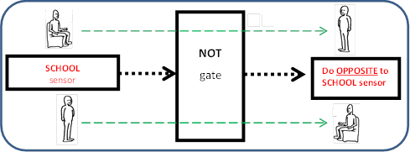
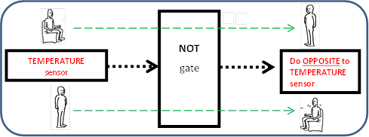
Bo01ean Logic Game – LOGIC GATE Cards

Slide 6
Bo01ean Logic Game – DATA DECODER Card

